Slide 1
Introduction to
e-commerce

Slide 2

Electronic commerce
To many people the term electronic commerce, often shortened to e-commerce, is equivalent to shopping on the web.
The term electronic business is sometimes used to capture the broader notion of e-commerce.
In this session, we will use e-commerce in its broadest sense. It encompasses both web and mobile shopping and other business conducted electronically.

Slide 3
E-commerce is not new
Banks have used electronic funds transfers or (EFTs), also called wire transfers, for decades.
Businesses have been engaging in electronic data interchange for years. EDI occurs when one business transmits computer readable data in a standard format to another business.

Slide 4
Electronic data interchange
In the 1960s businesses realised that many of the documents they exchanged related to the shipping of goods and contained the same set of information for each transaction.
By sending the information electronically in a standard format, the businesses could save money on printing, mailing, and re-entry of data.
Electronic transfer of data also introduces fewer errors than manual transfer.

Slide 5
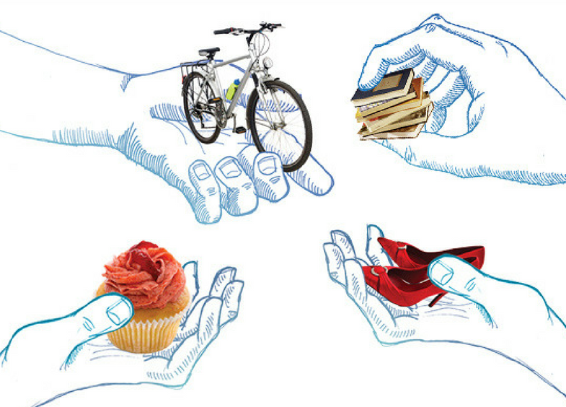
Origins of commerce
The origins of traditional commerce predate recorded history.
Commerce is based on the specialisation of skills. Instead of performing all services and producing all goods independently, people rely on each other for the goods and services they need.
Example: My family trades apples to one of our neighbors in exchange for repairs to the fences in our house who in turn trades apples for shoes.

Slide 6

Traditional commerce
Although money has replaced bartering, the basic mechanics of commerce remain the same: one member of society creates something of value that another member of society desires.
Commerce is a negotiated exchange of valuable objects or services between at least two parties and includes all activities that each of the parties undertakes the complete the transaction.

Slide 7
Technology and commerce
In order to understand how technology can aid commerce businesses need to understand traditional commerce.
Once we have identified what activities are involved in traditional commerce, we can consider how technology can improve them.
Note that technology does not always improve commerce. Knowing when technology will NOT help is also useful.

Slide 8

E-commerce
e-commerce is the use of electronic data transmission to implement, buying and selling on internet or enhancement any business activity.
Example: A buyer sends an electronic purchase order to a seller. The seller provides goods and services and then send an electronic invoice back to the buyer. The payment is ay also be made electronically.
When used appropriately, electronic transactions can save both time and money, provide bigger target market, and create new business opportunities.

Slide 9
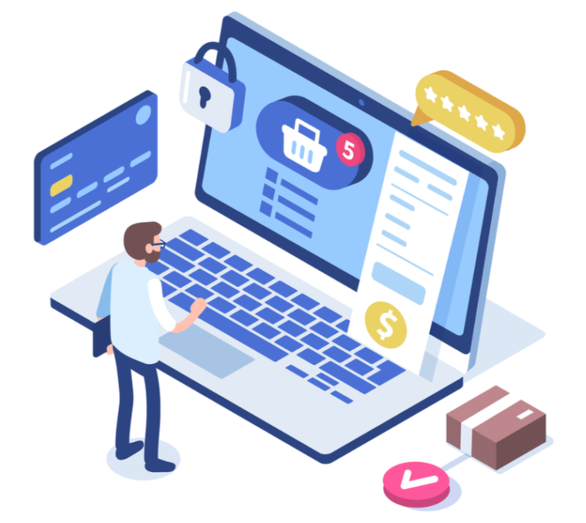
Impact of e-commerce
E-commerce is changing the way traditional commerce is conducted:
Technology can help throughout the process including promotion, searching, selecting, negotiating, delivery, and support.
The value chain is being reconfigured with number of intermediaries reduced.

Slide 10

Appropriateness
It is important to identify which business processes can be streamlined using e-commerce technologies.
It is equally important to realise that some processes make effective use of traditional commerce and cannot be improved upon using technology.
Technology is not a solution for all processes. Using it when it is not necessary or helpful can be a costly mistake.
Are there any process you can think that cannot be done by technology at present?

Slide 11

Well-suited for e-commerce
Business processes that are well-suited for e-commerce:
The business products and services that are ideal to e-commerce
Online delivery of software.
Advertising and promotion of travel services
Online tracking of shipments.
Commodity items.
Product or service that has become standardised like Sale/purchase of new books and household items
Products or services with lower customisation.
Electronic payments.

Slide 12
Best for traditional commerce
Business processes that are well-suited to traditional commerce:
Sale/purchase of high fashion clothing
Sale/purchase of perishable food products
Sale of expensive jewellery and antiques
Real estate
In general, products that buyers prefer to touch, smell, or otherwise closely examine are difficult to sell using e-commerce.

Slide 13

Questionable cases
Would e-commerce or traditional commerce work best for the following activities?
Sale/purchase of rare books
Browsing through new books
Sale/purchase of shoes
Sale/purchase of collectibles (trading cards, plates, etc.)

Slide 14
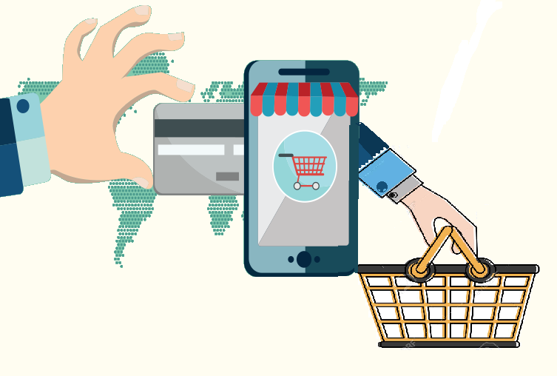
Combinations of both traditional and e-commerce models
Some business processes can be handled well using a combination of electronic and traditional methods:
Online banking
Sale/purchase of automobiles
Advertising spare rooms
Sale/purchase of investment/insurance products
Cash on delivery for products or services ordered online
How do you verify identity or deposit cash to App only based banks like Monzo?

Slide 15
Advantages of e-commerce
Increases the speed and accuracy with which
businesses able exchange information
Electronic payments (tax refunds, paychecks,
etc.) cost less to issue and are more secure
Can make products and services available in
remote areas
Enables people to work from home, providing
scheduling flexibility

Slide 16
Advantages of e-commerce
For the seller:
Increases sales/decreases cost
Lower entry and exit cost
Makes promotion easier for smaller firms
Can be used to reach narrow market segments
Lower overheads and taxes in some cases
For the buyer:
Makes it easier to obtain competitive bids
Provides a wider range of choices
Provides an easy way to customize the level of
detail in the information obtained
How Governments can create an equal competitive environment for traditional and online businesses?

Slide 17
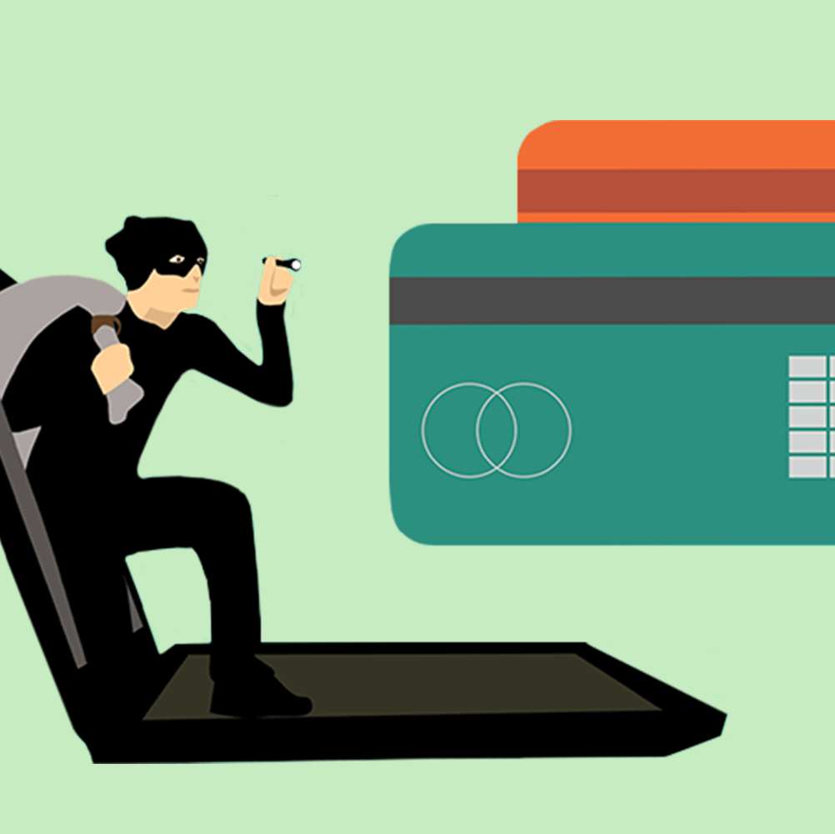
Disadvantages of e-commerce
Some business processes are not suited to e-commerce, even with improvements in technology
Many products and services require a critical mass of potential buyers (e.g. online grocers)
Costs and returns on e-commerce can be difficult to quantify and estimate
Cultural impediments: People are reluctant to change in order to integrate new technology
The legal environment is uncertain: Courts and legislators are trying to catch up.

Slide 18
Why Primark does not sell online?
Significant cost involved in warehousing and delivery
Cost involved in ecommerce website design and maintenance
Limited add-on purchase opportunities
Lack of Economies of Scale
E-Commerce require needs a “back end” with very high functionality that links into inventory, logistics, customer accounts and finance systems.

Slide 19
Notable e-commerce Challenges
In 2018, Next had to make an accounting adjustment when it realised that the staffing and management cost of handling “click and collect” orders in-store was £0.89 per parcel and not the £0.57 previously assumed.
On Etsy, the cost of returns on a £5.00 item can be around £6.50.
IKEA rely on add-on purchase and some products share same components

Slide 20
Future of e-commerce
Combining VR and AR to create Mixed Reality
Direct to Consumers (D2C)-from manufacturer or producers to consumers
Robotics and Drone based deliveries
Emergence of Voice commerce and headless technology powered IoT devices

Slide 21


The End…

